Slide 1
The Theory of Reasoned Action

Slide 2
Today’s lecture
The Theory of Reasoned Action and its component variables.
Organ donation as an example issue of how these variables influence behavior.

Slide 3
The Theory of Reasoned Action (TRA)
Ajzen & Fishbein are the principal theorists associated with TRA.
Highly rational/linear view of attitudes and behaviors.
Key assumptions:
Attitudes predict behaviors.
If we can increase someone’s intent to behave in a certain way, they are likely to actually behave that way.
Thoughts about those assumptions?

Slide 4
Let’s review!
What determines the strength of the link between attitudes and behavior?
We don’t confuse multiple attitudes with single attitudes.
There are repeated opportunities for behavior.
Attitudes are based on personal experience and direct observation (as opposed to “hearsay”).
Attitudes are central to a person’s value system.
The possibility of social desirability is minimized.
An individual is a low self monitor.
The possibility of non-attitudes is minimized.
The accessibility of our attitudes is high.
The same will be true of the attitude-intent link.

Slide 5
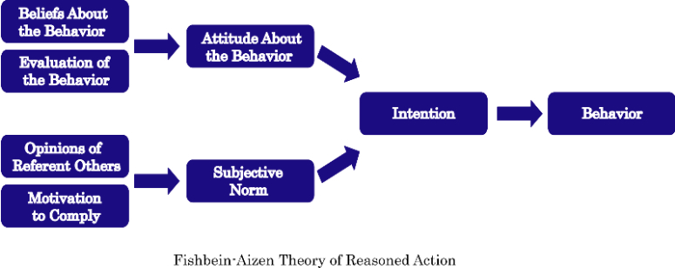
The Theory of Reasoned Action

Slide 6
What determines a person’s intent?
Two things determine the intent to behave in a particular way:
Attitudes about the behavior
Beliefs about the behavior
Reading the textbook makes me sleepy.
Evaluation of those beliefs
It’s great because I have trouble falling asleep.
Subjective norms (what other people think we should do)
How we think important people in our life would feel about this behavior.
My mom wants me to read the textbook for class.
Our motivation to comply with their opinions.
I like making my mom happy, so I’ll read the book.

Slide 7
Attitudes
What are YOUR beliefs about registering to be an organ donor?

Slide 8
Common beliefs about organ donation
“Organ donation saves lives.”
Good or bad??
Issues of deservingness

Slide 9
Beliefs about organ donation
“Organ donation is against my religion.”
Big concern vs. small concern
“Default” reason when reason for attitudes aren’t known

Slide 10
Beliefs about organ donation
“Doctors might not save me if they know I’m a donor.”
Related to medical mistrust.

Slide 11
Beliefs about donation
“My organs will just be sold on the black market.”
Not unrelated: “Rich people can buy their way to the top of the waiting list.”

Slide 12
Other beliefs about donation
It’s too disgusting to even think about.
It freaks me out. If I think about it, something bad might happen to me.

Slide 13
Another organ donation belief
“Organ donors are good people.”

Slide 14
Social Norms
Determinants of social norms:
Reminder: What we think people who are important to us want us to do * Motivation to comply with those people’s wishes
How do social norms affect how YOU behave with regard to organ donation?
About 25% of the time, people who talk to their family members about donation become more negative in their attitudes (and behavioral intentions) toward donation.

Slide 15
Analyze this!
Lots of organizations create campaigns to promote organ donation:
Donate Life America
The Kidney Foundation
International governments
What do you think about the following messages that other organizations have used to promote organ donation?

Slide 16
A couple of early campaigns
The University Worksite Organ Donation Project (UWOD) & the New Jersey Workplace Partnership for Life
Used TRA as the theoretical foundation for campaign messages.

Slide 17
Organ Donation Campaign, continued
Even when past campaigns addressed common myths, donation didn’t go up.
People couldn’t explain why they didn’t want to donate.
Most researchers looked only for “rational” reasons.
Non-rational reasons include superstitions and disgust (“ick” and “jinx” factors).
We had to add these reasons to our theoretical model.

Slide 18
Results were good, but not great…
… so we developed a campaign for driver’s license bureaus.
Worked with the Michigan’s Secretary of State offices to implement the “Tell Us Now” campaign.
A special challenge was reaching African Americans. The donor willingness rate was virtually the lowest in the U.S.
One perception that we had to counter was that when African Americans donate, rich white people would get their organs.
The truth was that African Americans received a disproportionate number of transplants, and they were overwhelmingly from white donors. (See http://minorityhealth.hhs.gov or just Google “African Americans and organ donation”).
Another challenge: Clerks aren’t allowed to ask “the question.”

Slide 19
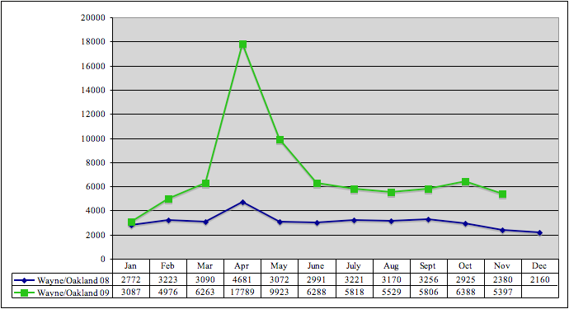
Results
Media and POD resulted in 829 new registries in primarily African American zip code (~360% increase).
The addition of interpersonal interventions led to 5,144 new registrations above baseline (~1,258% increase).
POD alone resulted in 643 new registries above baseline (~283% increase).

Slide 20
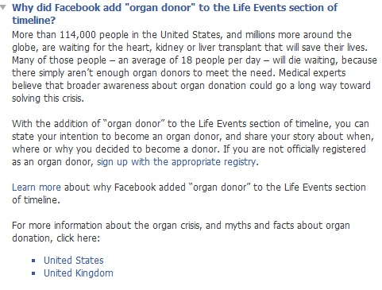
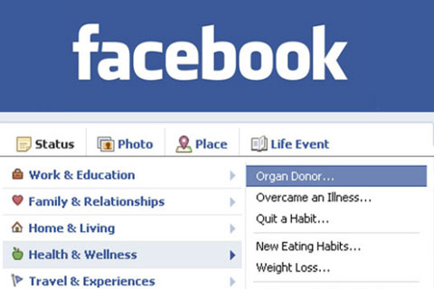

Facebook/social media
What do you think about Facebook’s contribution to organ donation?

Slide 21
Social scientific evidence for the theory
Most successful model for predicting intention to behave.
Good predictor for a variety of behaviors.
Attitude component is a good predictor on its own.
Most successful when predicting intention when people have performed the same (or related) behavior in the past.
Doesn’t account for non-rational reasons for behavior or the barriers people have to overcome (unless you use an extended version of the theory).

